Slide 1
Garmin InReach Training
Revised: 3/7/19

Slide 2
This talk will be posted under the Help tab on our website.

Slide 3
Contents
1. Introduction
2. Using the InReach on a trip (general)
3. Operating a Garmin InReach (specific)
4. Hands-on experience

Slide 4
Introduction
1. The device
2. Features we will use
3. Types of messages
4. Our message plan

Slide 5
The Garmin InReach
%
Time
Shows time and % charged on top
SOS button under red cover on mid-right
Green color for icon selected
We'll be talking about the buttons / icons in detail later.

Slide 6
Features we will use
1. Send SMS/text or email
To the center or other pre-entered numbers or email addresses
To a number or address that you enter
To another InReach device.
2. Send an SOS
(The units have other capabilities that aren't included in our message plan.)

Slide 7
Types of messages
1. Preset (messages we send routinely on trips). First word is "Info".
2. Quick text (most common problem messages). First word is "Alert" or "Help".
3. Letter-by-letter messages (for unusual circumstances or additional information).

Slide 8
Preset messages
Have predefined text and recipients.
Our three Preset messages are addressed to the Center Manager and Program Coordinator.

Slide 9
Preset messages (cont'd)
These messages inform center personnel of our status.
The choices are:
1. Info: At the Trailhead
2. Info: On our way back
3. Info: Running late

Slide 10
Using the InReach on a trip
1. Typical trip
2. Van problem or other non-emergency problem
3. Emergency
Note: The device works best if you're outside, with a clear view of the sky and the antenna in that direction.

Slide 11
Typical trip
1. One or two days before
The center turns on the unit and charges it if less than 50% charged.
2. When the van driver picks up the van keys & InReach
The driver turns on the unit outside and waits until it stops flashing red, checks the % charged, then leaves it on.

Slide 12
Typical trip (cont'd)
3. After arriving at the trailhead
The driver sends a Preset "Info: At the Trailhead" message.
Listens for the "chirp" that it has been sent.
4. After starting the van at the end of the hike
The driver sends a Preset "Info: On our way back" message.
Listens for the "chirp" that it has been sent.

Slide 13
Typical trip (cont'd)
5. After returning to the center
The driver turns off the unit
Returns the device to the center with a note "Charge it" if the charge is less than 50%.

Slide 14
If there's a non-emergency problem
1. Try to reach the center using a cell phone.
2. If that doesn't work, there are some already entered Quick Text choices. Use the most applicable one.

Slide 15
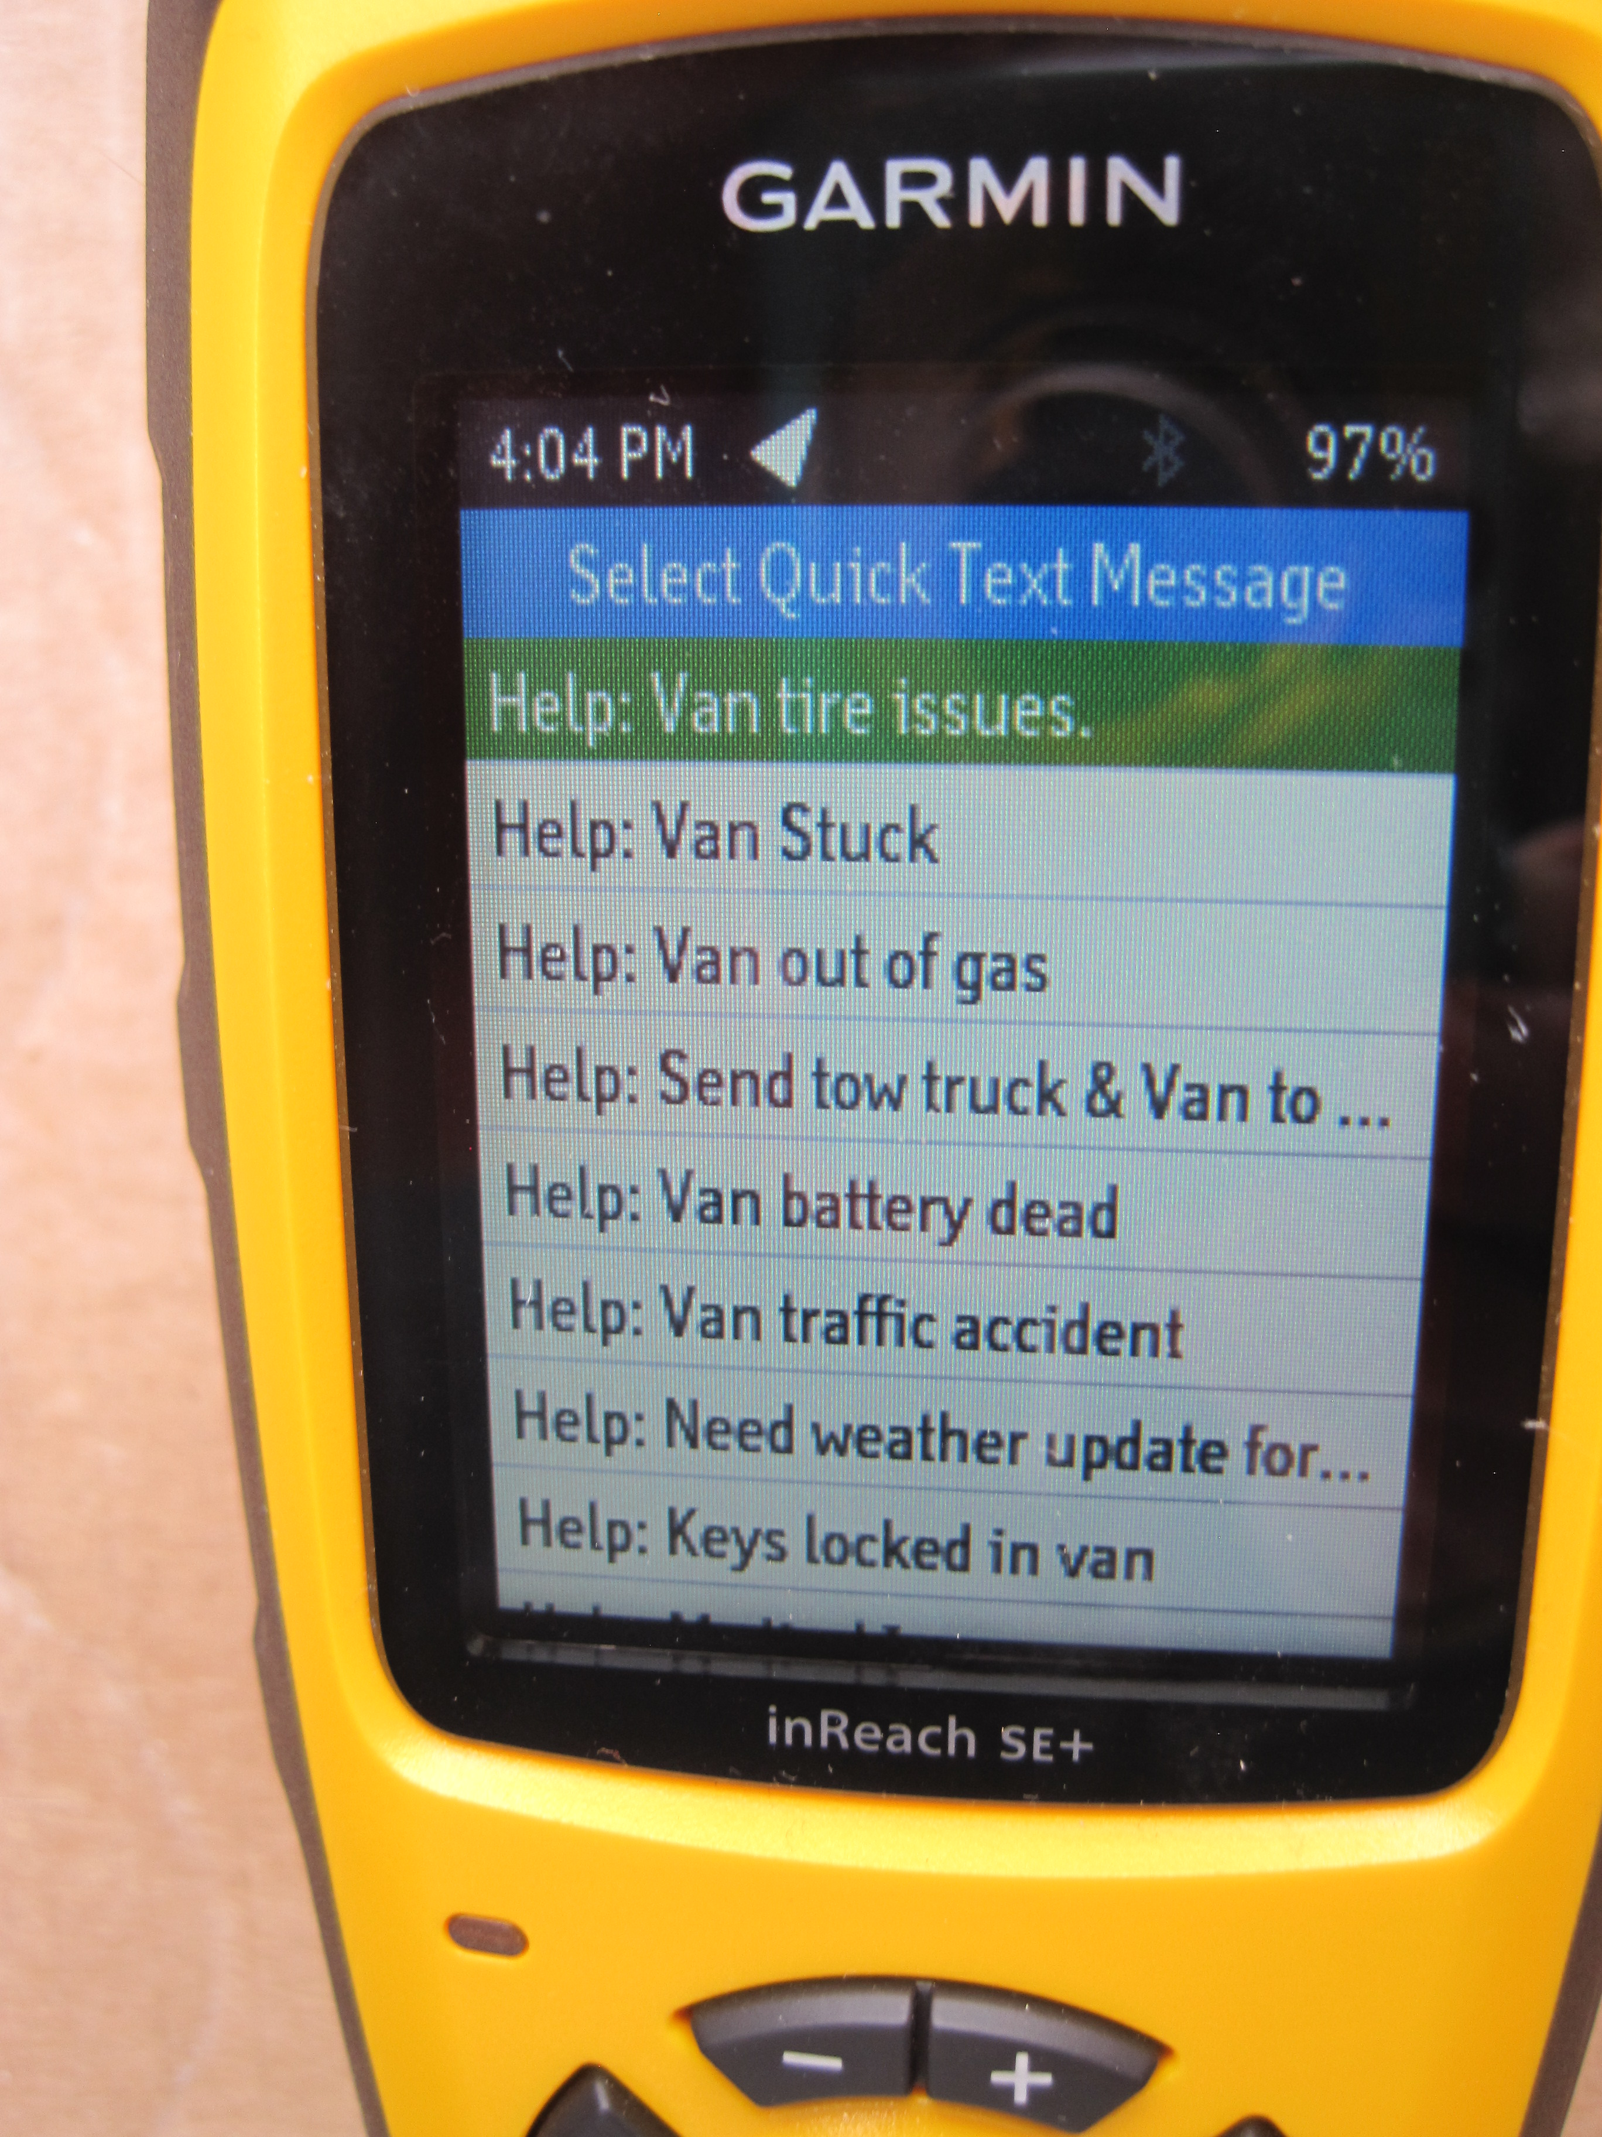
If there's a non-emergency problem (cont'd)
Various van-related problems (stuck, out of gas, inoperable, battery dead, accident, keys locked inside)
Weather update

Slide 16
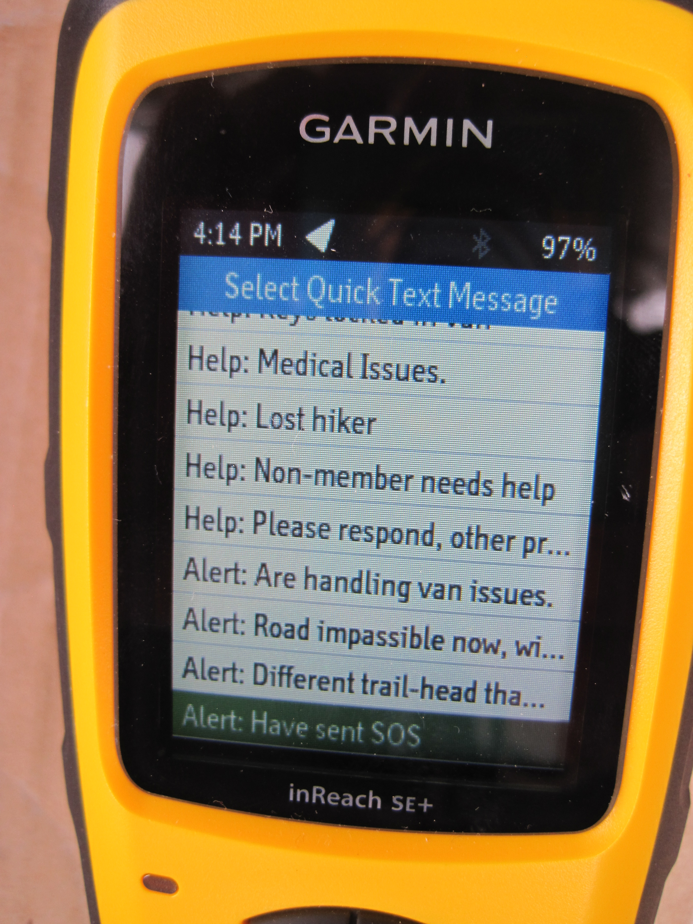
If there's a non-emergency problem (cont'd)
Medical issues
Lost hiker
Someone else needs help
Other problem

Slide 17
Alerting the center
Van issues that we're handling.
Impassible road right now.
We changed the hike to somewhere else.
Have sent an SOS.

Slide 18
If there's an emergency
1. Try to call 911 using a cell phone. Also try to call the center.
2. If that doesn't work, send an SOS message.
The unit will stay on.
Emergency personnel will text you back.
You will need to compose a response letter-by-letter.

Slide 19
Our message plan
Our three Preset messages are always free.
We get 20 SMS/text messages (Quick Text or entered) per month for each unit.
If the device goes over the first twenty, the additional messages cost 50 cents each.
We are charged for incoming as well as outgoing messages.

Slide 20
Operating a Garmin InReach
Charging
Buttons
Icons
How to turn on the device
How to wake it up
Sending and receiving messages
How to turn off the device

Slide 21
Charging an InReach
Open the flap on the bottom of the unit.
Plug in the provided power cord and attach it to anything that has a USB port and access to charge (a wall plug, a portable power bank, or a computer that is powered on).

Slide 22
Charging an InReach (cont'd)
1. After being fully discharged, the device takes 5-7 hours to fully charge.
2. A typical hike will use about 10% of the charge.

Slide 23
The buttons we use are:
On/Off
On/Off button
SOS
SOS
On/off on top.
SOS under red cover on right side.
Additional buttons on the bottom (next slide).

Slide 24
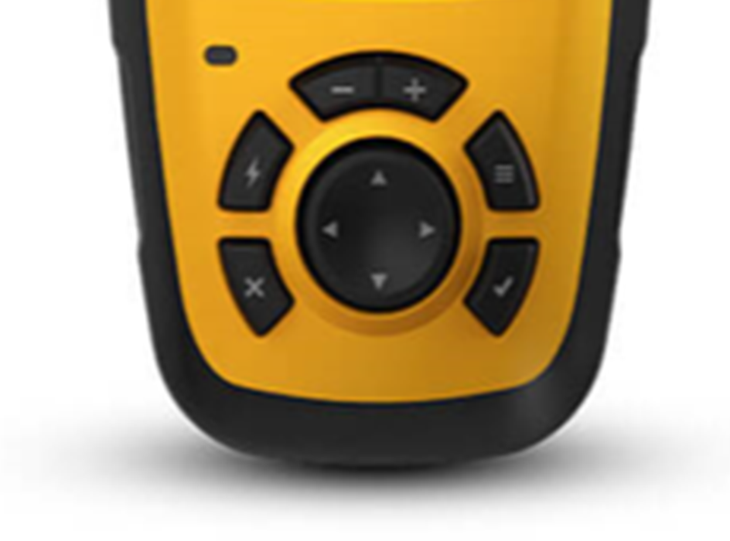
Backspace
Add a space
Status light
Menu
(Usually returns to Home page)
Shortcut menu
Back/Exit
Enter (✔)
Arrow Rocker - Select/Highlight

Slide 25
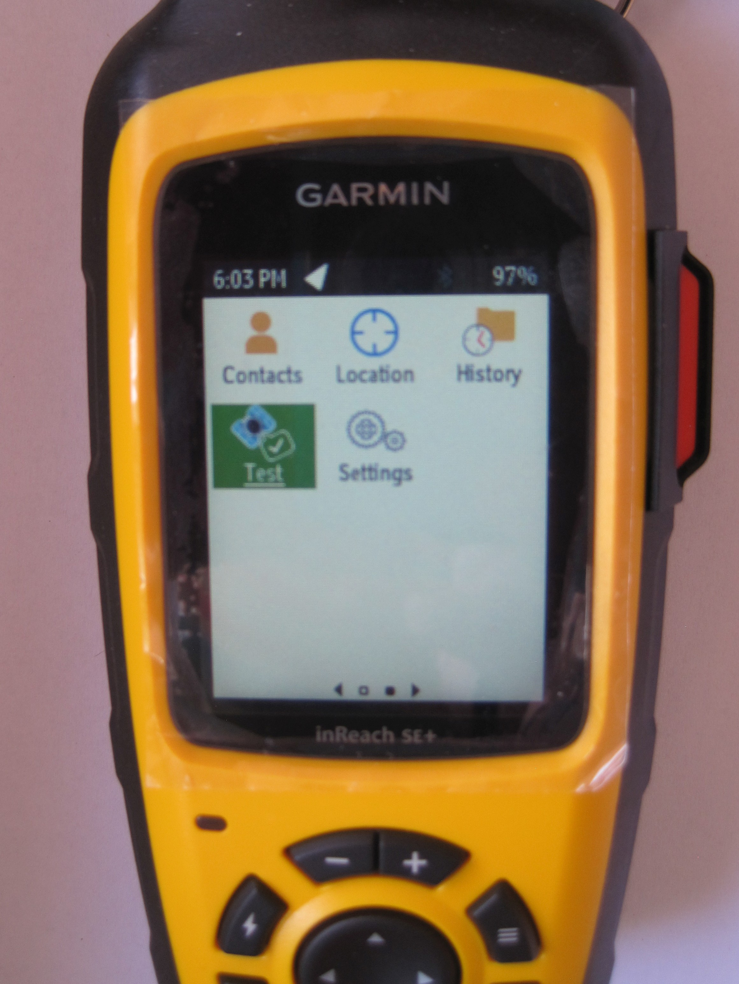
There are two screens of icons
First screen
Second screen

Slide 26
Tips for making selections
Anything selected will be highlighted in green.
You'll use the arrow rocker and the Enter (✔) button A LOT.

Slide 27
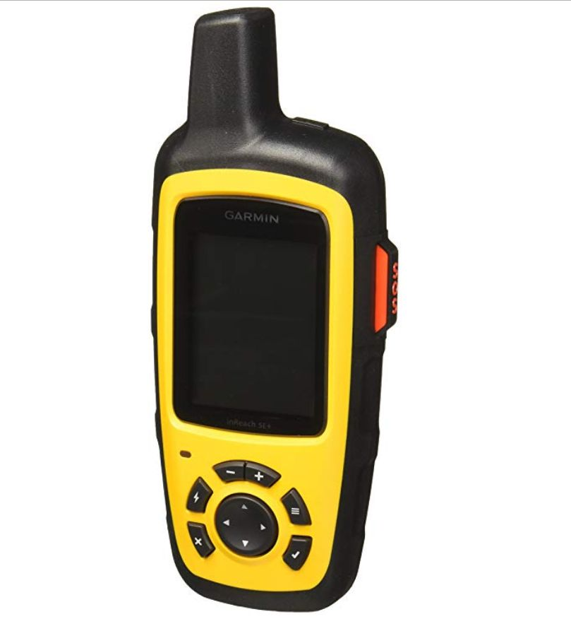
How to turn on the device. Step 1
On/Off
Press the On/Off button on the top and the screen will light up.

Slide 28
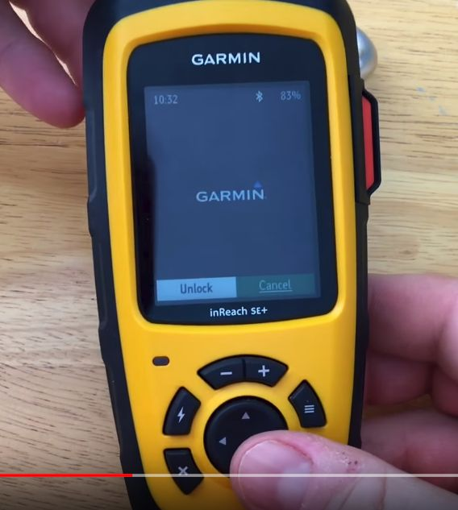
How to turn on the device (cont'd). Step 2
Bar
Using the arrow rocker, move highlighted (green) bar from “Cancel” to “Unlock” .
Press Enter (✔).

Slide 29
How to wake up the device
The device will go to stand-by (dark screen) after 2 min.
Wake it up by pressing Enter (✔).

Slide 30
How to check location accuracy
Use arrow rocker to get to the Location icon on second screen
Press Enter (✔).

Slide 31
How to check location accuracy (cont'd)
Location accuracy given as +- feet.
The location coordinates are displayed in degrees, decimal minutes (our choice).
Compare with the location coordinates on your GPS.

Slide 32
Coordinate systems for latitude & longitude
1. Decimal degrees
(e.g., N34.7902, W106.3803)
2. Degrees, decimal minutes
(e.g., N34 47.414, W106 22.820)
[60 minutes per degree]
How location coordinates are automatically included in an InReach message
Used on ASCHG website and how location coordinates are set to display on the InReach.

Slide 33
Message design for Preset and Quick Text messages
The person who receives the message should be able to tell at a glance how important it is.
The significant words of a message should be visible on the InReach screen to help the hiker quickly choose which message to send.
The set of messages includes problems or alerts that we have experienced or could experience.

Slide 34
The Preset messages are:
1. Info: At the Trailhead
2. Info: On our way back
3. Info: Running late

Slide 35
The Quick Text messages are:
1. Help: Van tire issues
2. Help: Van Stuck
3. Help: Van out of gas
4. Help: Send tow truck & Van to pick up participants.
5. Help: Van battery dead
6. Help: Van traffic accident
7. Help: Need weather update for our area
8. Help: Keys locked in van

Slide 36
The Quick Text messages are (cont'd):
9. Help: Medical issues
10. Help: Lost hiker
11. Help: Non-member needs help
12. Help: Please respond, other problem
13. Alert: Are handling van issues
14. Alert: Road impassible now, will update
15. Alert: Different trail-head than planned
16. Alert: Have sent SOS

Slide 37
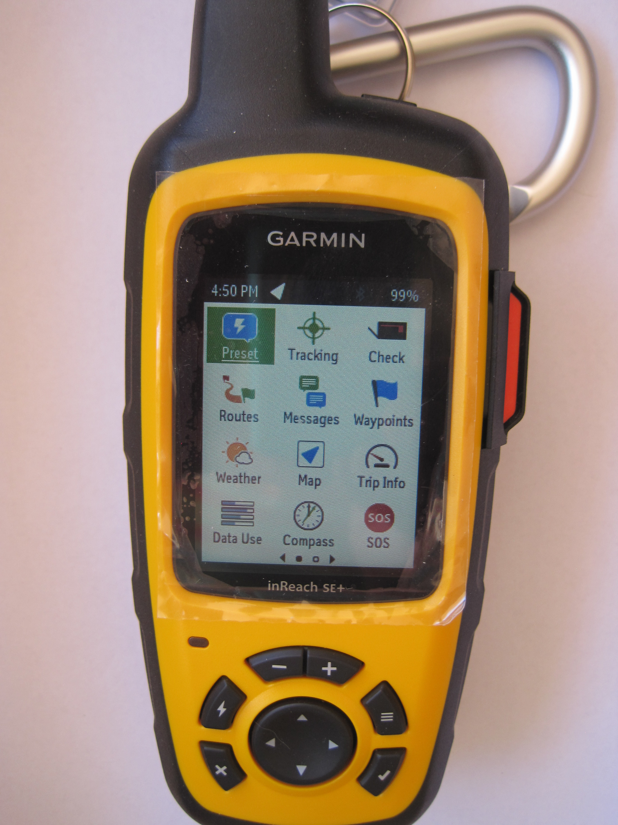
How to send a routine Preset message
Use the arrow rocker to move to the Preset icon.
Press Enter (✔).

Slide 38
How to send a routine Preset message (cont'd)
The three Preset messages will be displayed.
Highlight the Send in the message you want to send using the arrow rocker.
Press Enter (✔).

Slide 39
How to send a routine Preset message (cont'd)
That message will be sent automatically to the Center Manager & Program Coordinator for that unit.

Slide 40
Quick Text messages -- for non-emergency problems or alerts
You choose who receives this type of message. Pick one or more from the Contacts list or type the phone number(s) or email address(es).
Pick the appropriate Quick Text message or type the message.

Slide 41
If you don't know the names of the center & program managers:
Highlight the Preset icon.
Press Enter (✔).
Those contact names will be displayed.

Slide 42
How to send a Quick SMS/text message (cont'd)
1. Use the arrow rocker to highlight the Messages icon.
2. Press Enter (✔).

Slide 43
3. Highlight the "New Message" box.
4. Press Enter (✔).

Slide 44
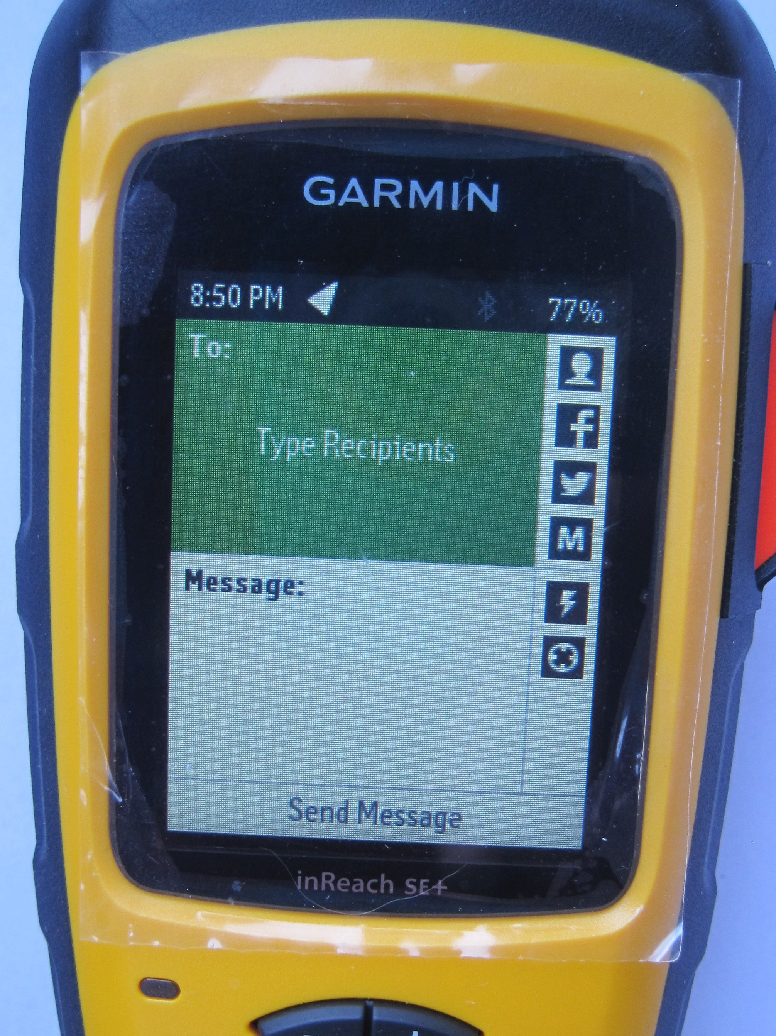
Head
This screen will appear.
Do you see the “Head” in the top right hand corner?

Slide 45
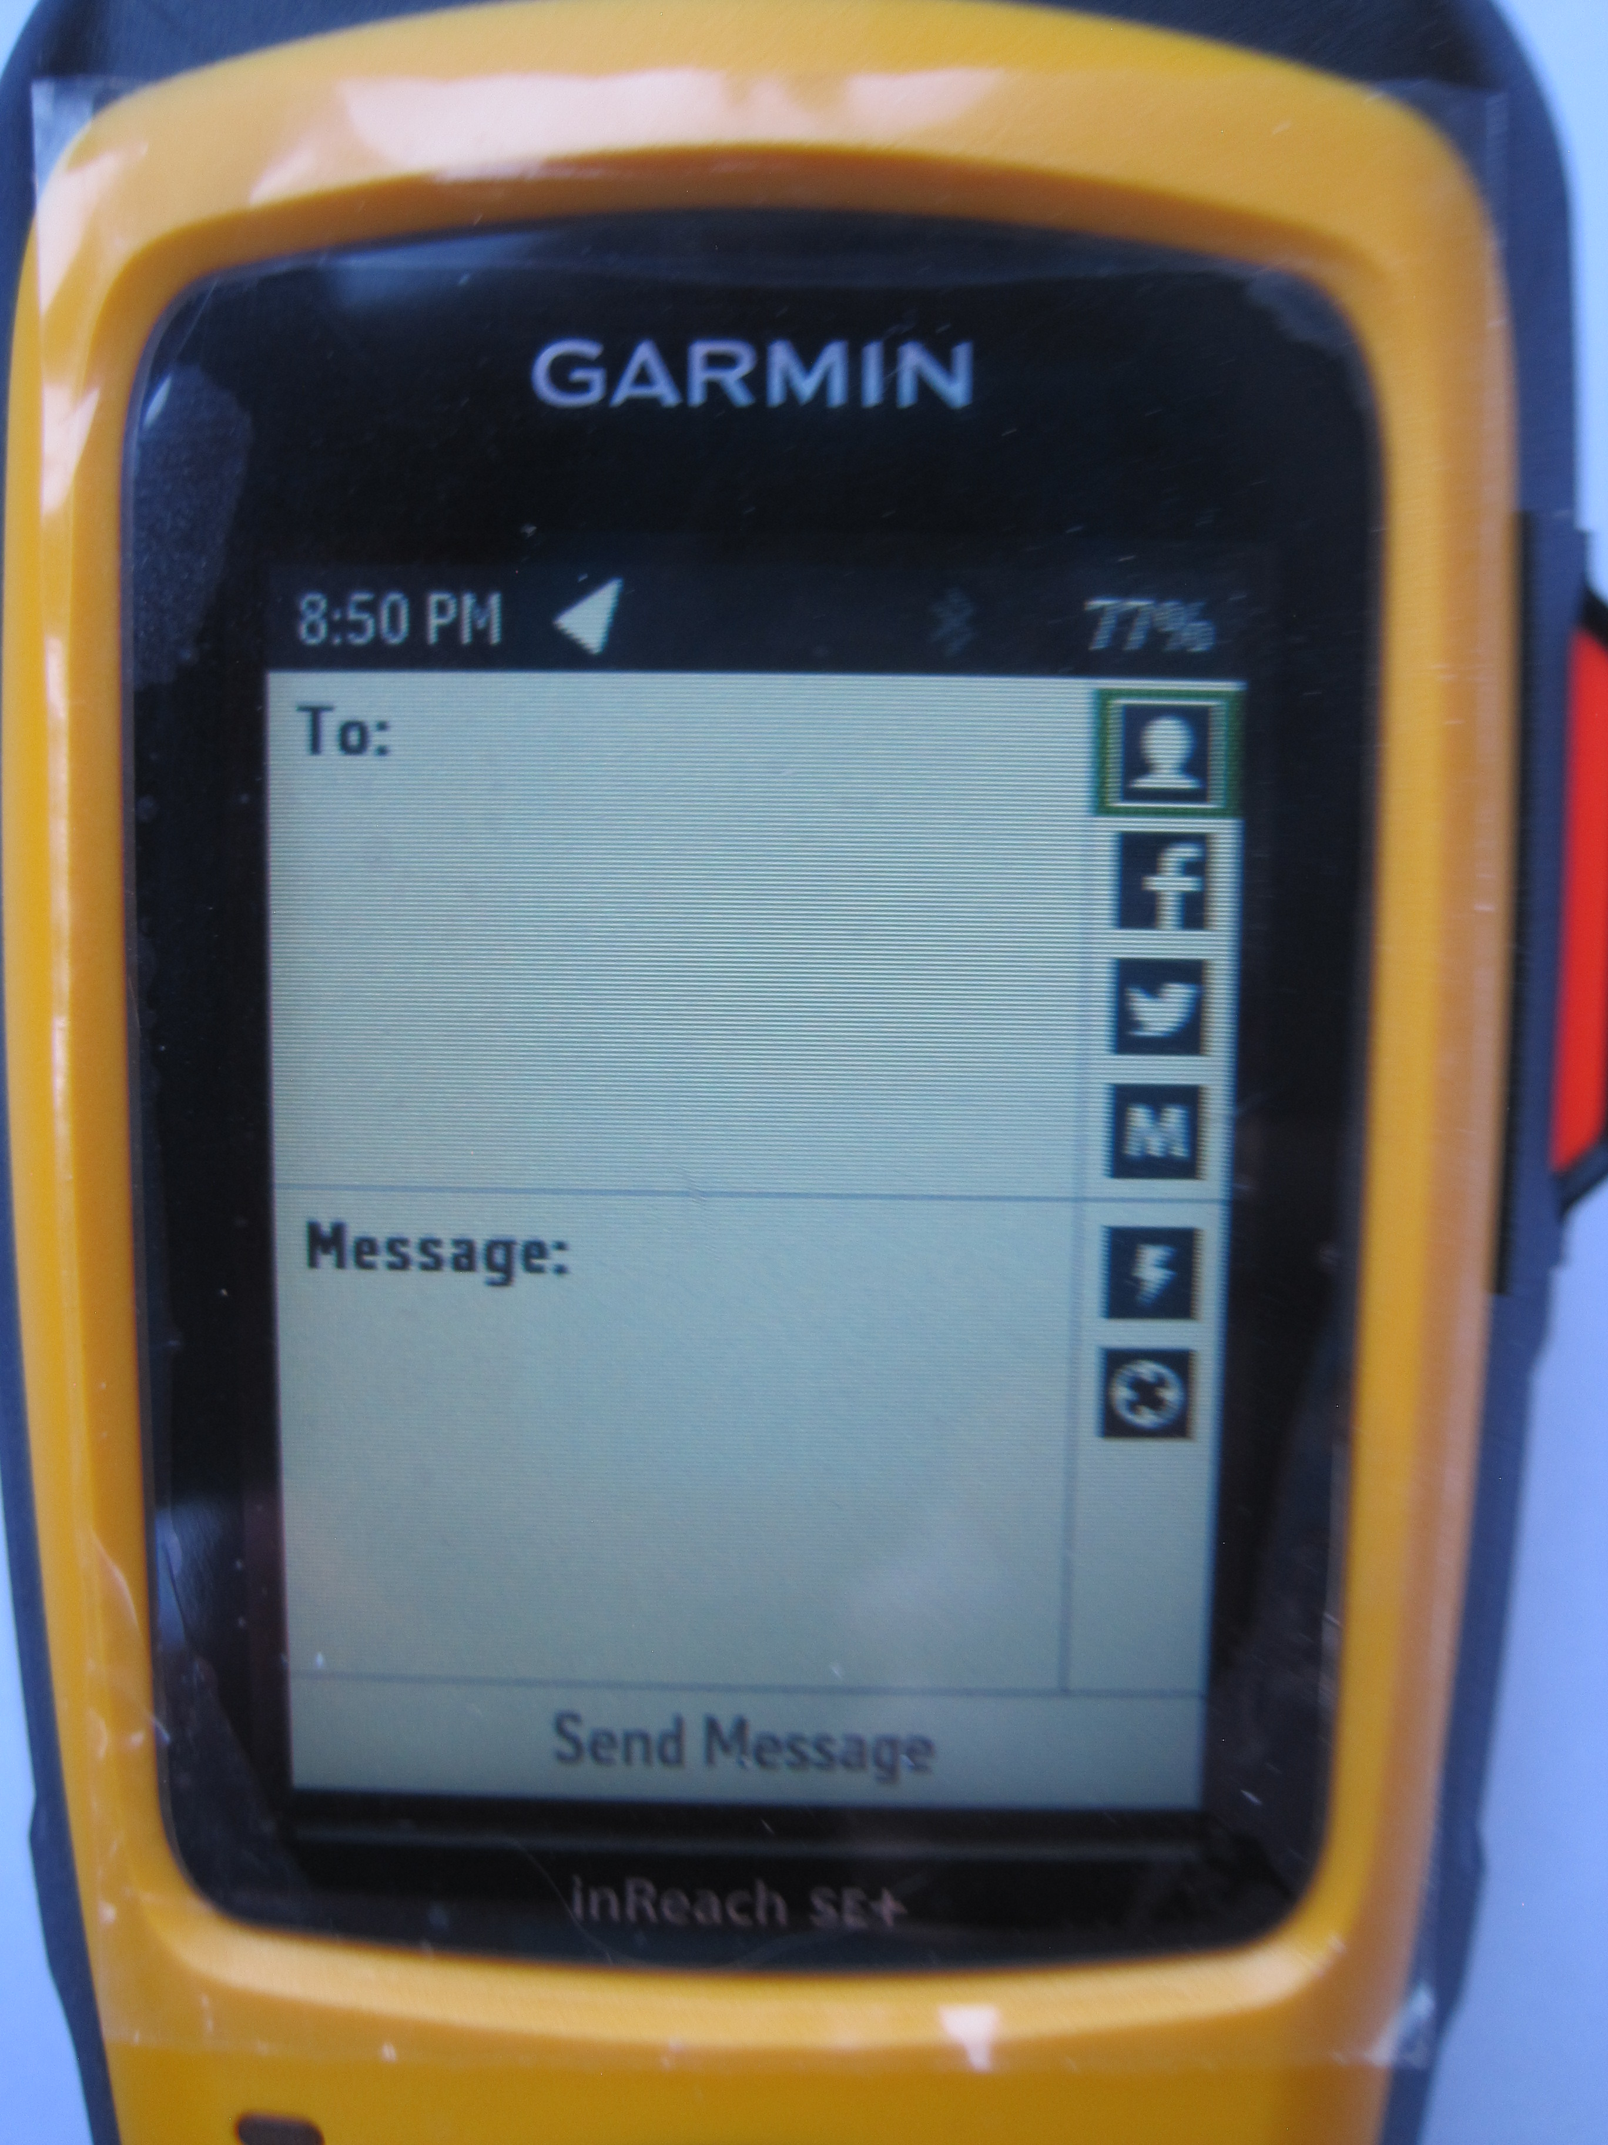
5. Use the arrow rocker to highlight the “head icon” box. 6. Then press Enter (✔).
Head

Slide 46
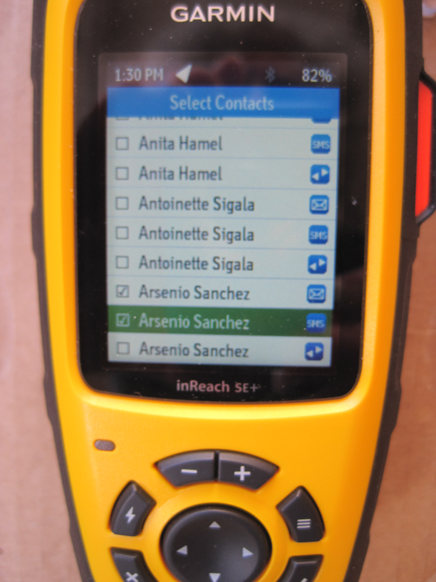
You'll get this contact list screen. 7. Use the arrow rocker to select a contact (email or SMS/text). 8. Press Enter (✔) to "check the box". 9. Repeat for next contact. 10. Press Exit/Back to return to the message.

Slide 47
11. Use the arrow rocker to highlight the “lightning bolt” box. 12. Press Enter (✔).

Slide 48
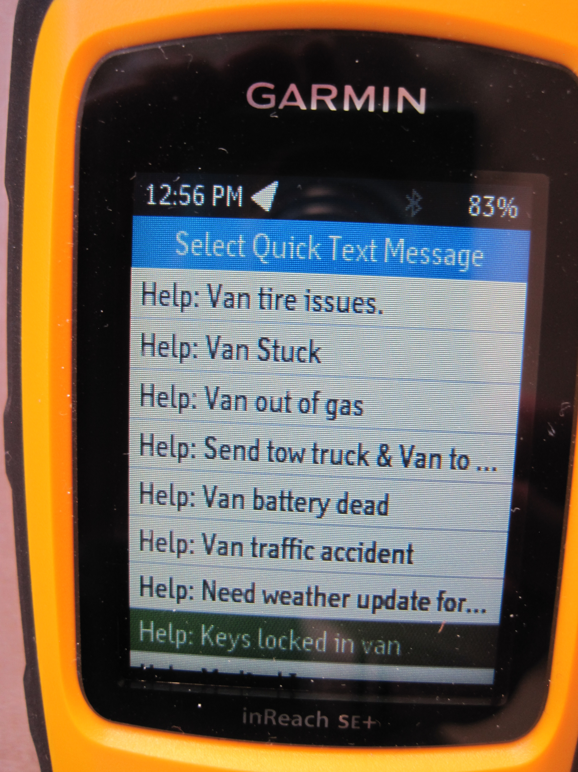
13. Select the Quick Text message you want. 14. Press Enter (✔).

Slide 49
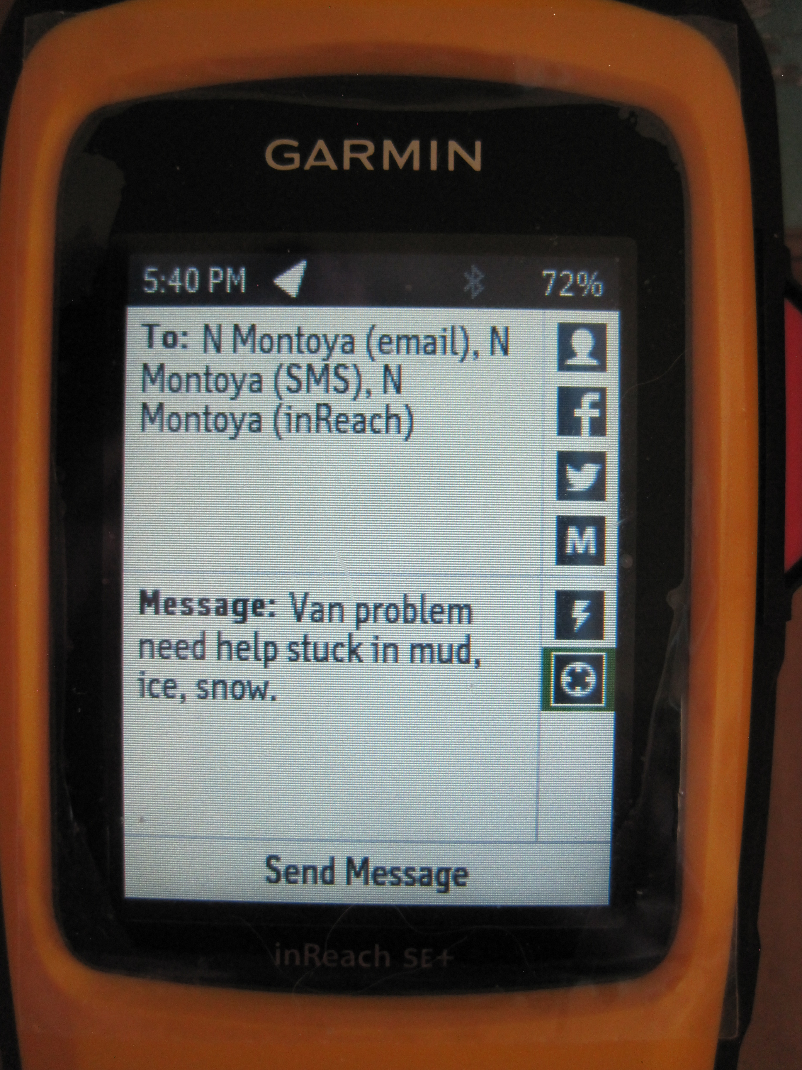
It's possible to add the location coordinates to the message Use the arrow rocker to highlight the "x marks the spot" box. Press Enter (✔).

Slide 50
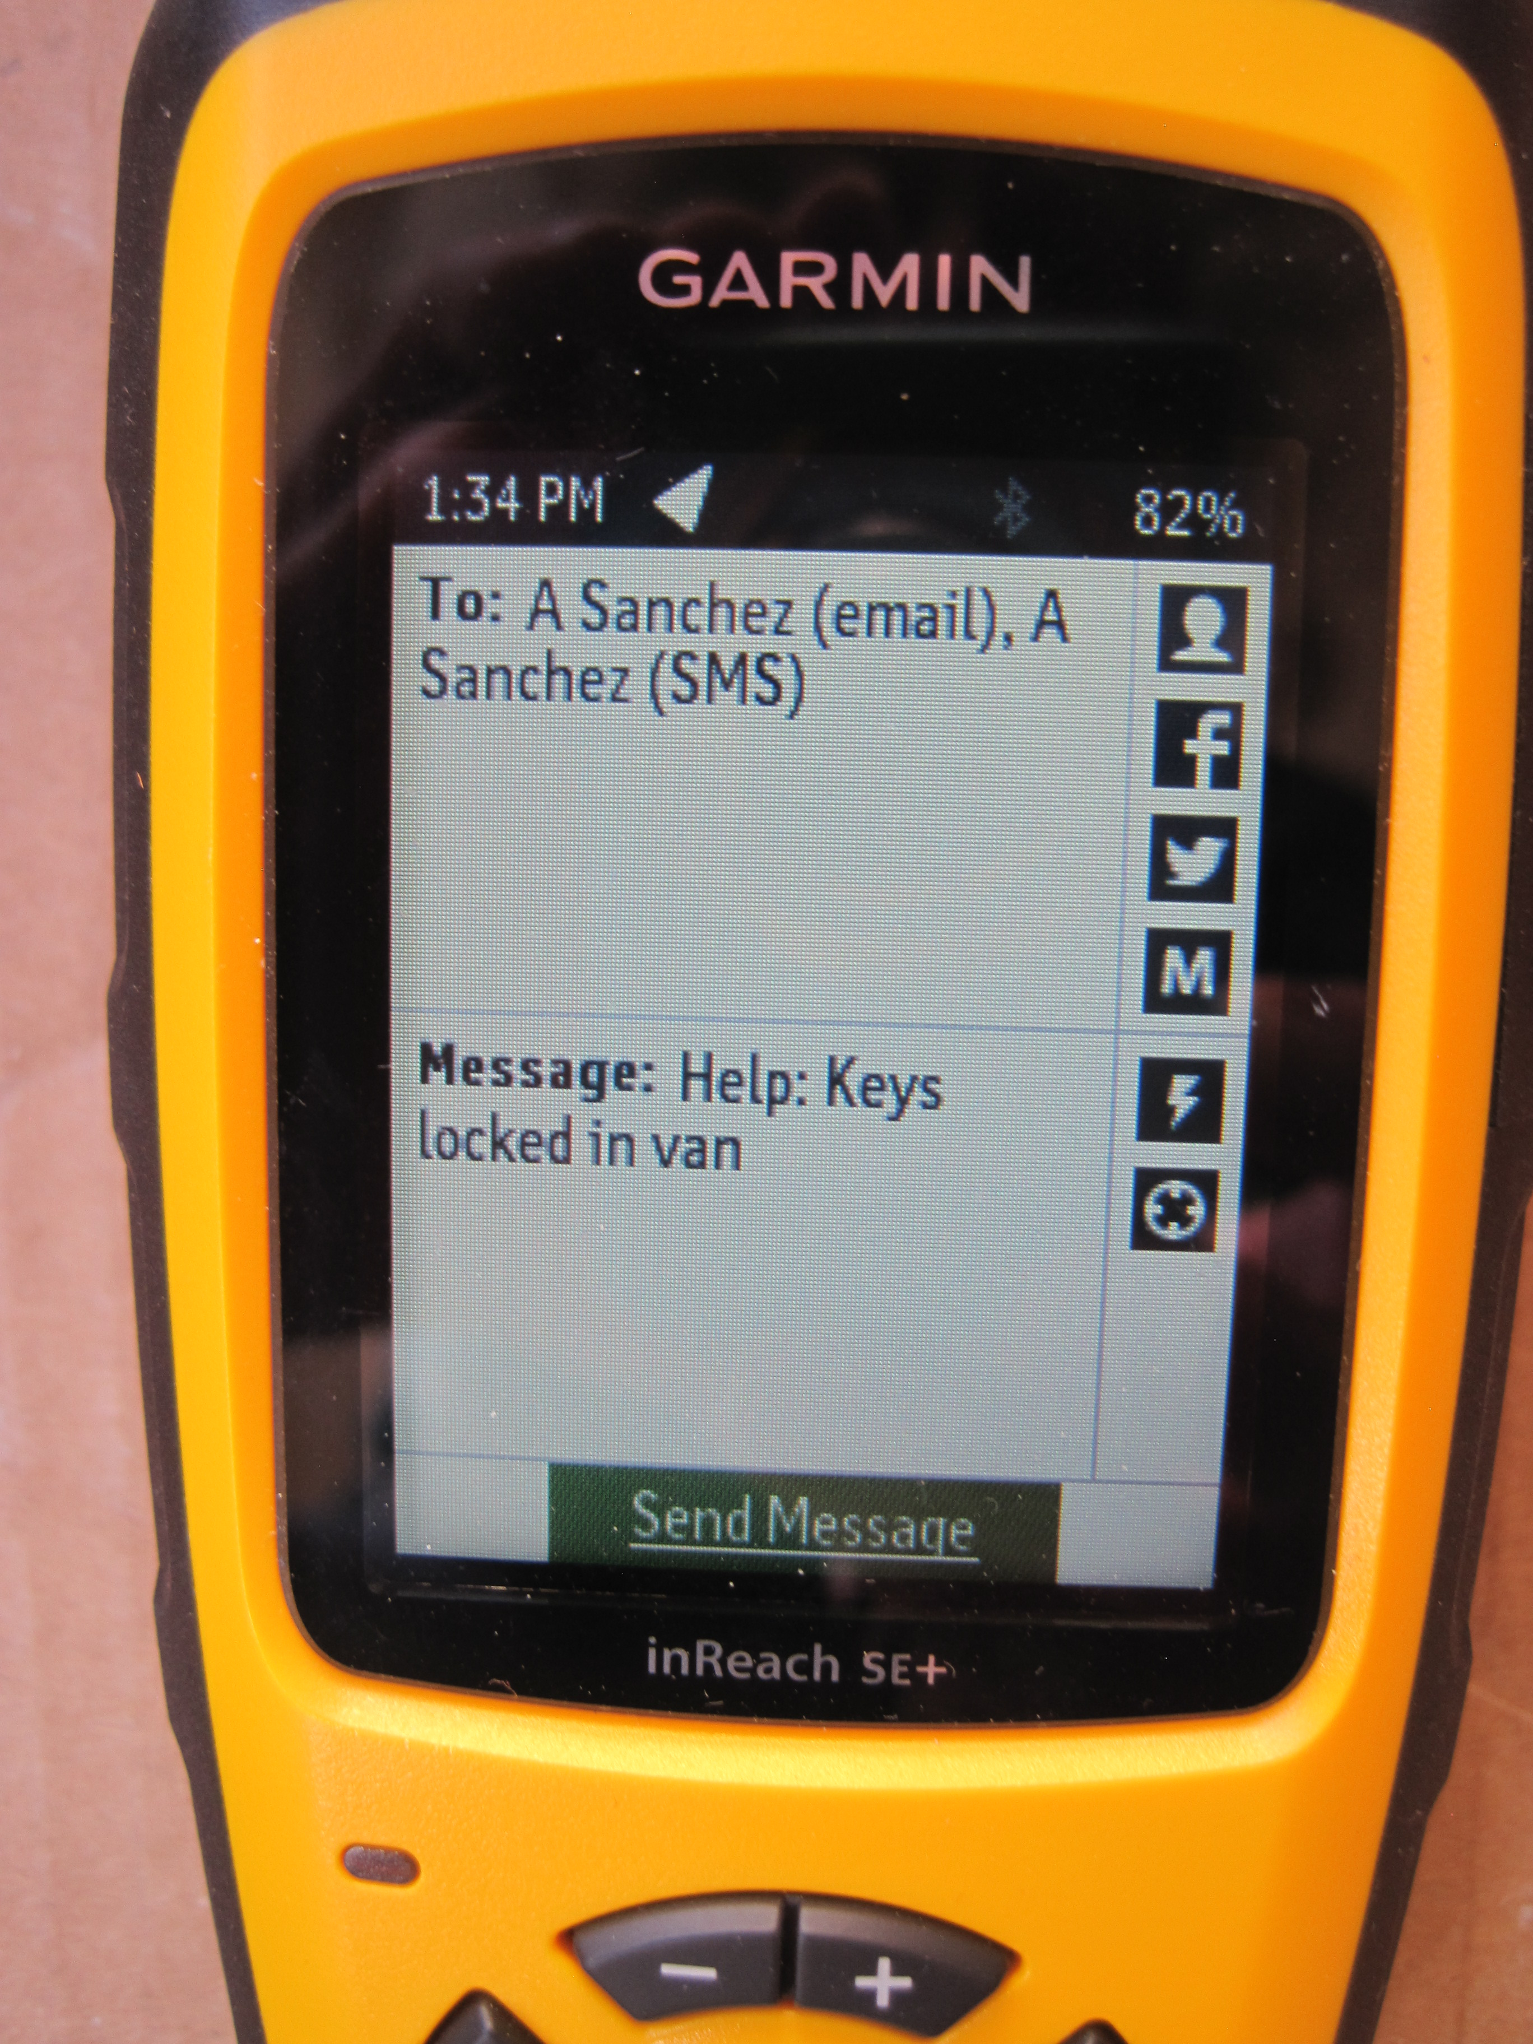
Here is your composed message.

Slide 51
To tell the device that your message is ready:
Highlight the "Send Message” box. Press Enter (✔).

Slide 52
Go where you have a clear view of the sky and wait for a chirp sound (it may take a minute or two). Your message has been sent.

Slide 53
Sample message received via email

Slide 54
Note that:
1. The message "From" is the Center Manager who "owns" the device.
2. There's a link to view the location on a map.
3. The location coordinates are sent with the message.

Slide 55
Click on link to get this map/reply box

Slide 56
Message received on cell phone

Slide 57
Map from link on cell phone

Slide 58
Checking for messages
The unit will automatically check for messages at the time interval chosen when the unit was set up (default is every 10 min).
You can always check for messages yourself.

Slide 59
Checking for messages (cont'd)
Use the arrow rocker to highlight the Check icon.
Press Enter (✔).

Slide 60
To read/reply to a message:
1. A buzzing sound will occur.
2. Select the messages icon. Press Enter (✔).
3. Scroll down to the message received (numbered red box identifier). Press Enter (✔). Read the message.
4. Reply to the message by typing or by using a Quick SMS/text or Preset message.

Slide 61
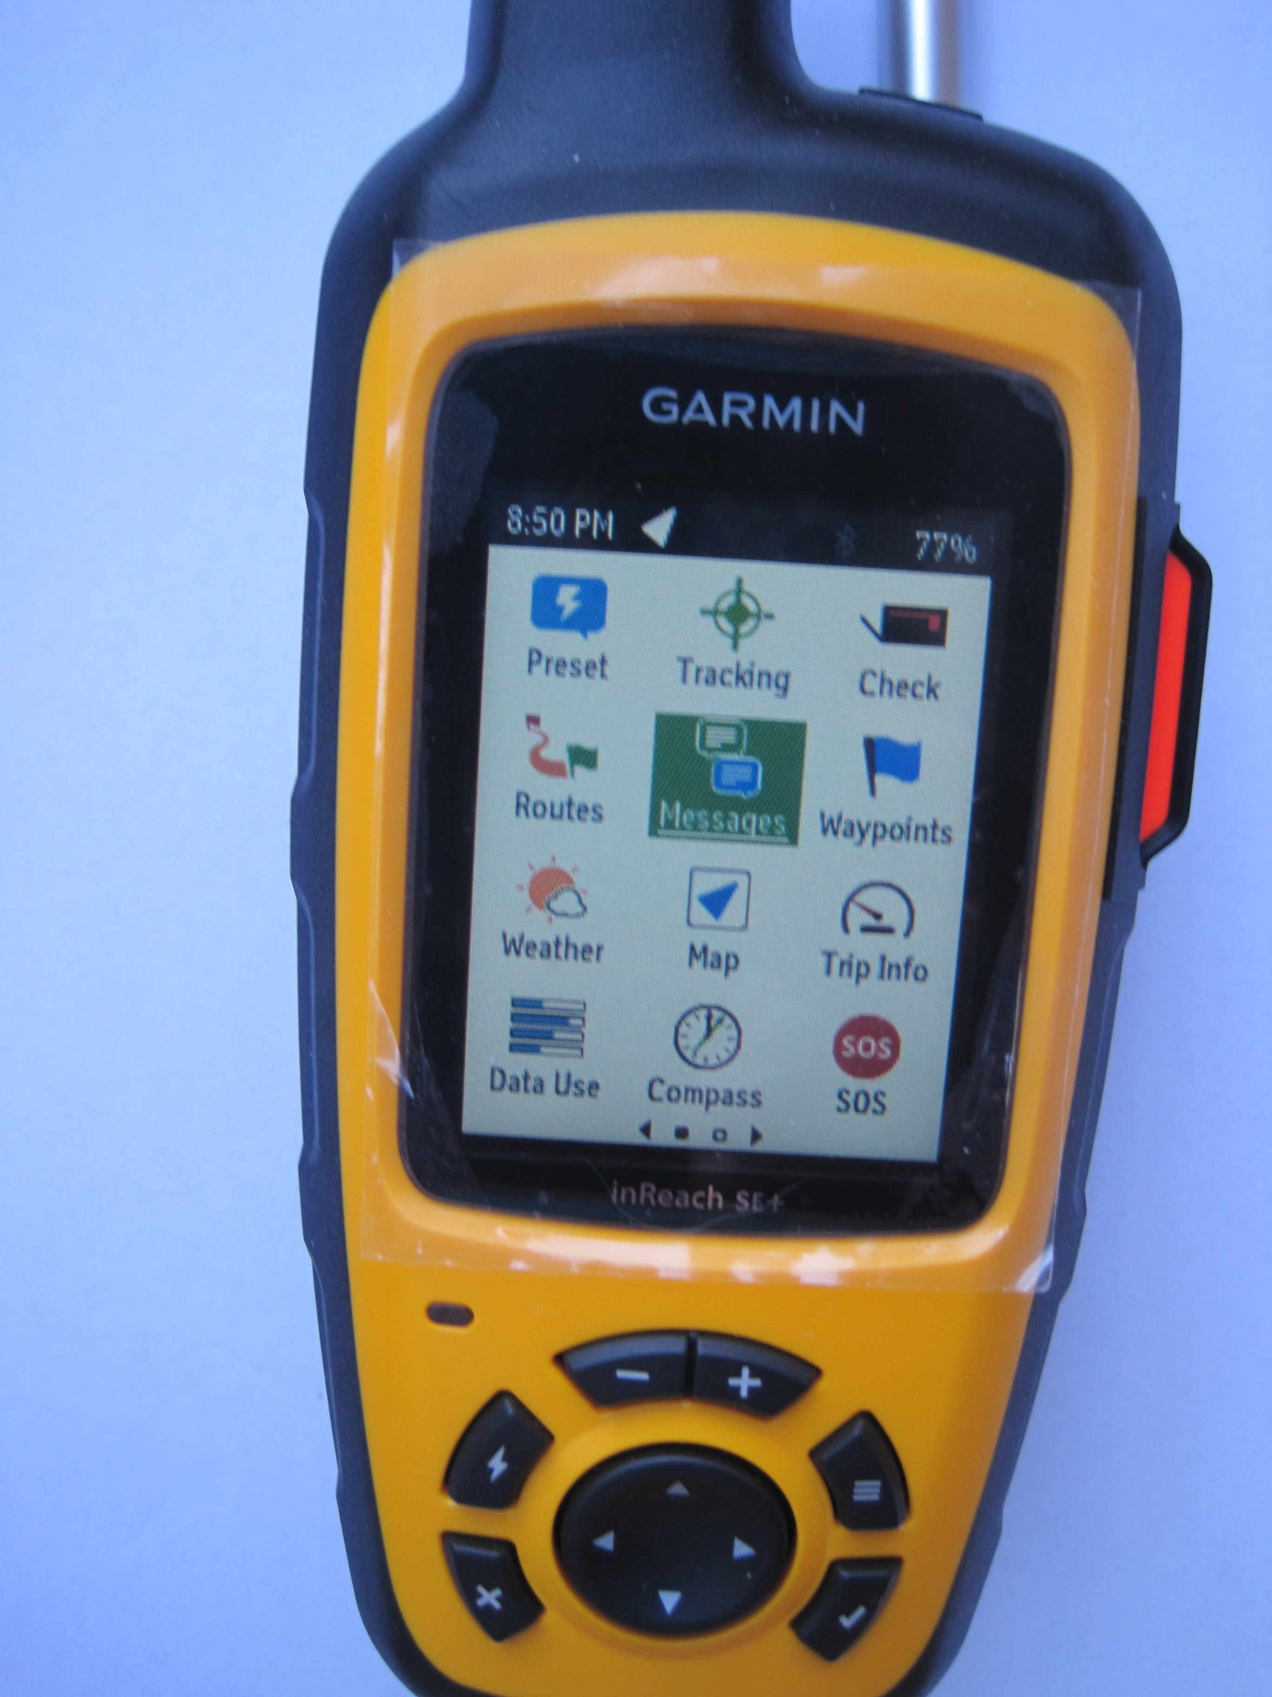
To read a message:
A buzzing sound will occur when you have a new message.
Select the messages icon.
Press Enter (✔).

Slide 62
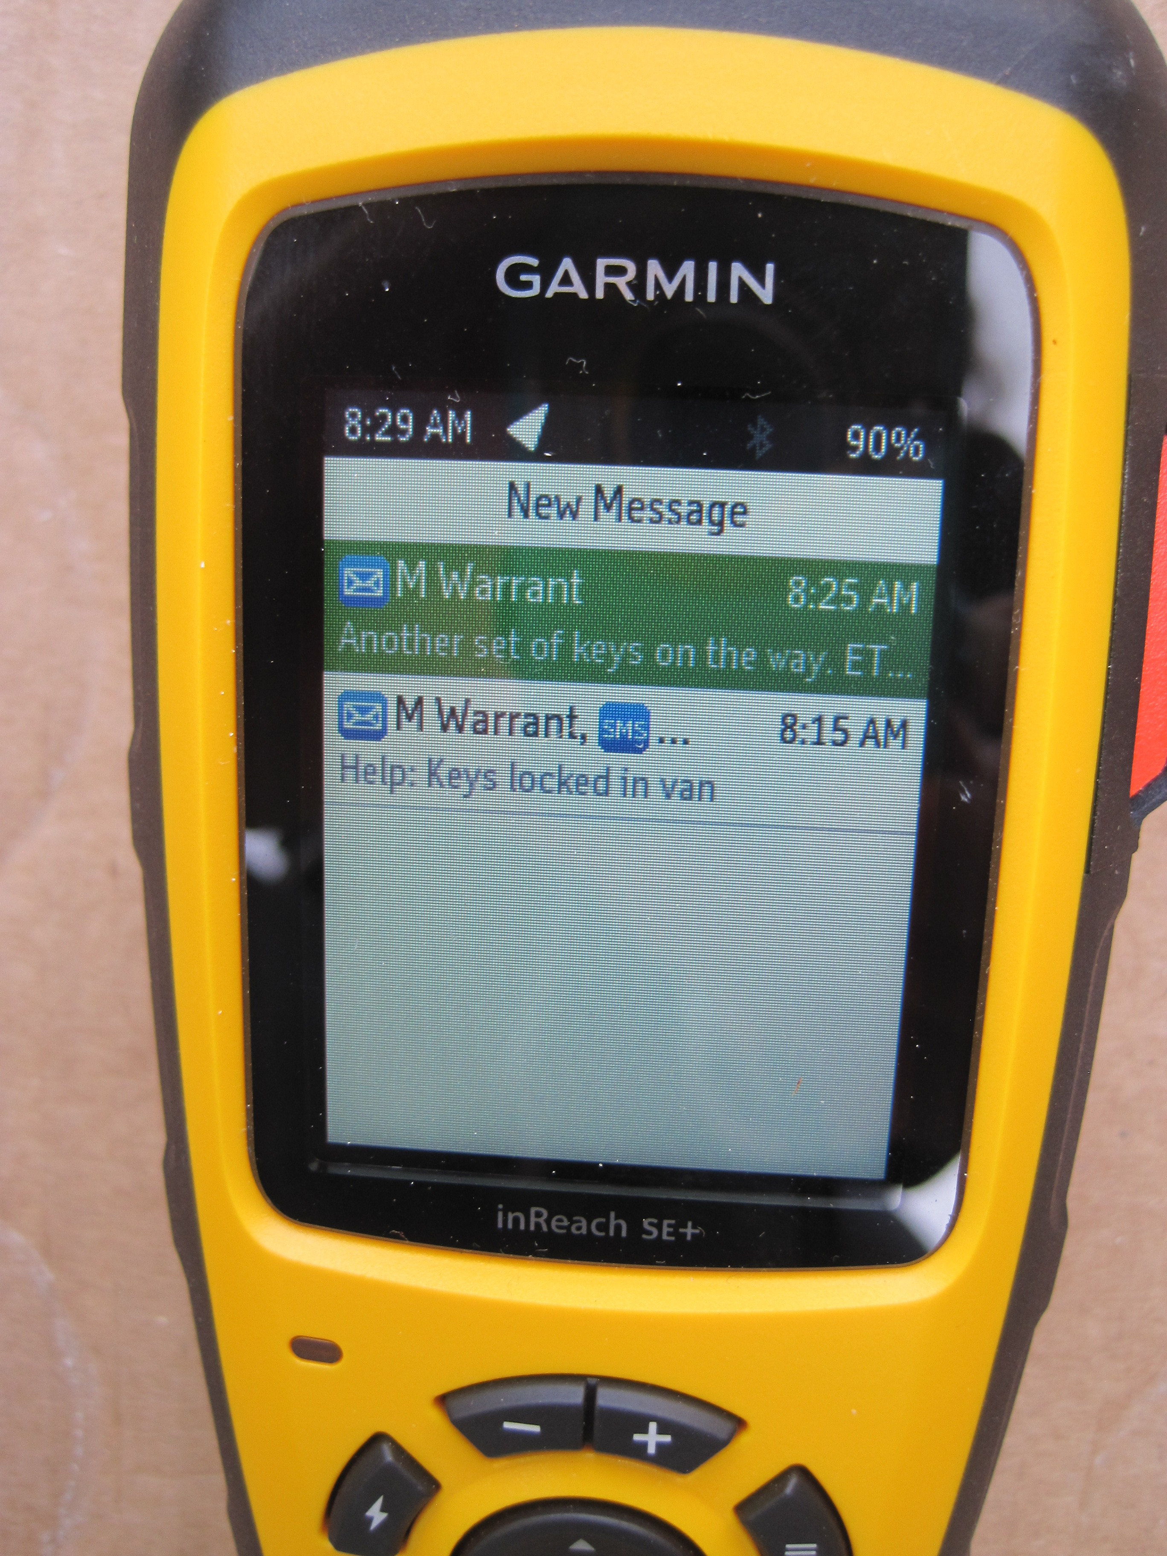
To read a message (cont'd):
1. Highlight the message
2. Press Enter (✔)
3. Read the full message.

Slide 63
To reply to a message:
Select "Type Reply".
Enter text letter by letter.

Slide 64
How to send an SOS
Button
1. Red SOS button on right hand side of device.
2. Red SOS icon on first screen
We recommend using the covered button.
Icon

Slide 65
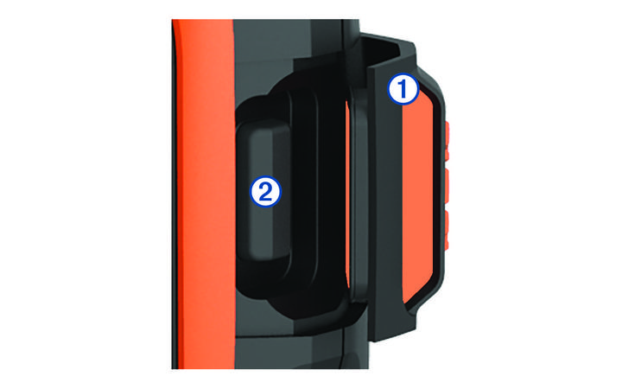
Initiating an SOS Rescue
FIRST – try to call 911 on a cell phone.
1. Lift the protective cap (1) from the SOS button (2).
2. Press and hold the SOS button.

Slide 66
Initiating an SOS Rescue (cont'd)
3. Wait for the SOS countdown (you can cancel until the countdown ends).
The device sends a default message to the GEOS emergency response service with details about your location.
The GEOS emergency response service will send you a confirmation message.

Slide 67
Initiating an SOS Rescue (cont'd)
4. Type a reply to the confirmation message summarizing your problem.
(See next slide.)
5. Send the Quick Text message "Alert: Have sent SOS" to the Center Manager and Program Coordinator.

Slide 68
Creating an SMS/text message
Note: This is not a touch screen.
Select a number or letter using the arrow rocker, then press Enter (✔).
Watch on the screen as your text is added.

Slide 69
Creating an SMS/text message (cont'd)
You can toggle through three different input screens using the Menu button.
Use the + button to add a space.
Use the – button to back up (erase).

Slide 70
Creating an SMS/text message (cont'd)
When you're finished, use the arrow rocker to highlight "Done".
Press Enter (✔).
Done

Slide 71
Video (https://www.youtube.com/watch?v=z8XtPH5OMwc)

Slide 72
How to turn off the device
1. Wake it up.
2. Press the On/Off button.
3. Use the arrow rocker to highlight "Power Off".
4. Press Enter (✔).

Slide 73
Questions?

Slide 74
Hands-on Time

